Slide 1
Luggage tracker and monitoring system
23-NTU-CS-1059 (Ahmad sattar)
23-NTU-CS-1052 (ABU OBAIDA)
23-NTU-CS-1072 (SAAD EHTSHAM)

Slide 2
Project Overview
IoT-based luggage tracking system
Real-time location monitoring
Motion & tampering detection
Web-based monitoring using Blynk

Slide 3
Problem Statement
Luggage loss and theft during travel
Lack of affordable real-time tracking
Need for smart security solution

Slide 4
Objectives
Real-time GPS tracking
Motion & bag opening detection
Environmental monitoring
Web-based alerts

Slide 5
Hardware Components
ESP32 Microcontroller
GPS NEO-6M
PIR Motion Sensor
DHT11 Sensor
LDR Sensor
OLED Display
Buzzer

Slide 6
Software & Platform
Platform I/O
ESP32 Programming
Blynk Cloud
Blynk Web Dashboard

Slide 7
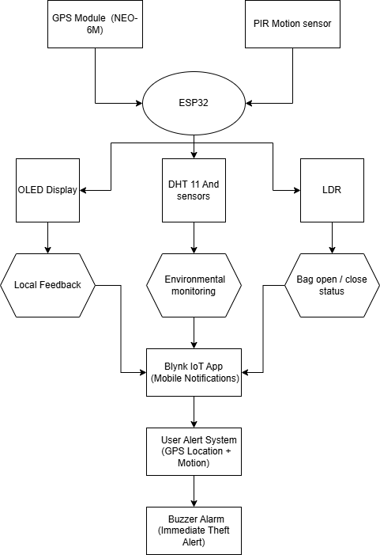
CIRCUIT DIAGRAM

Slide 8
System Data Flow
Sensors send data to ESP32
ESP32 processes data
Alerts via buzzer
Data sent to Blynk Cloud
Displayed on Blynk Web

Slide 9
Pin Mapping
# | Component | Signal / Pins | ESP32 GPIO | Power
1 | DHT11 (Temp & Humidity) | DATA | GPIO 4 | 3.3V
 |  | VCC | 3.3V
 |  | GND | GND
2 | PIR Motion Sensor | OUT | GPIO 27 | 5V
 |  | VCC | 5V
 |  | GND | GND
3 | LDR (Light Sensor) | Analog Signal | GPIO 34 (ADC) | 3.3V
 |  | GND | GND
4 | Buzzer | + | GPIO 26 | —
 |  | − | GND
5 | GPS NEO‑6M | TX | GPIO 16 | 3.3V / 5V
 |  | RX | GPIO 17
 |  | VCC | 3.3V / 5V
 |  | GND | GND
6 | OLED SSD1306 (I2C) | SDA | GPIO 21 | 3.3V
 |  | SCL | GPIO 22
 |  | VCC | 3.3V
 |  | GND | GND

Slide 10
DATA MAP (BLYNK)
Sensor / Data | Blynk Virtual Pin | Data Type
Temperature (DHT11) | V0 | Float
Humidity (DHT11) | V1 | Float
LDR (Light value) | V2 | Integer
PIR Motion | V3 | 0 / 1
GPS Latitude | V10 | Double
GPS Longitude | V11 | Double
GPS Satellites | V12 | Integer
GPS Altitude (m) | V13 | Double

Slide 11
CONCLUSION
The Smart Luggage Tracking and Monitoring System provides a reliable solution for luggage security during travel.
The system successfully integrates ESP32, GPS, and multiple sensors for real-time tracking and monitoring.
Motion detection and bag opening detection enhance theft prevention.
Data visualization through the Blynk Web Dashboard enables remote monitoring via a web browser.
The project demonstrates an effective application of IoT technology for real-world security problems.

